Slide 1

Core Java
Mrs A. S. Pardeshi

Slide 2
Syllabus
The Java Language: Features of Java, Java Data Types, Typecasting, Arrays
Unit I
OOPS: Introduction, Class, Object, Static Keywords, Constructors, Inheritance, Polymorphism, Abstraction, Encapsulation, Abstract Classes, Interfaces
String Manipulations
Packages: java.lang, java.util, java.io, java.sql, java.swing

Slide 3
Syllabus
Exception Handling
Unit II
Multithreading
I/O Streams
Networking

Slide 4
Syllabus
Wrapper Classes
Unit III
Collection : List, Set, Map
Inner classes: static, anonymous
AWT: Label, Button, CheckBox,List

Slide 5
Textbook(s):
Herbert Schildt, Java The Complete Reference, Ninth Edition, McGraw-Hill Education, 2014
Additional Reference(s):
1) E. Balagurusamy, Programming with Java, Tata McGraw-Hill Education India, 2014
2) Programming in JAVA, 2nd Ed, Sachin Malhotra & Saurabh Choudhary, Oxford Press
3) The Java Tutorials: http://docs.oracle.com/javase/tutorial/

Slide 6
Who Invented Java?
James Gostling and his team developed Java language at Sun Microsystem in early 90s.
What was first name of Java?
The earlier name of Java language was Oak. There was a Oak tree outside James office and hence so was the name.
Why Java is introduced?
Before Java, C and C++ was popular programming languages. But they provided connectivity between different machines. Developers want a language which will utilize the internet facility. As it was gaining popularity.

Slide 7
History
James Gosling initiated the Java language project in June 1991 for use in one of his many set-top box projects. The language, initially called ‘Oak’ named after an oak tree that stood outside Gosling's office, also went by the name ‘Green’ and ended up later being renamed as Java, from a list of random words.
Sun Microsystems released the first public implementation as Java 1.0 in 1995. It promised ‘Write Once, Run Anywhere’ (WORA) which meant ‘Write a Java program once, run it on any machine’. On 13 November, 2006, Sun released much of Java as free and open source software under the terms of the GNU General Public License (GPL).
On 8 May, 2007, Sun finished the process, making all of Java's core code free and open-source, aside from a small portion of code to which Sun did not hold the copyright.

Slide 8
Features
Java is −
Object Oriented − In Java, everything is an Object. Java can be easily extended since it is based on the Object model.
Platform Independent − Unlike many other programming languages including C and C++, when Java is compiled, it is not compiled into platform specific machine, rather into platform independent byte code. This byte code is distributed over the web and interpreted by the Java Virtual Machine (JVM) on whichever platform it is being run on.
Simple − Java is designed to be easy to learn. If you understand the basic concept of OOP.
Secure − With Java's secure feature, it enables to develop virus-free, tamper-free systems.
Architecture-neutral − Java compiler generates an architecture-neutral object file format, which makes the compiled code executable on many processors, with the presence of JVM.

Slide 9
Features
Java is −
Portable − Being architecture-neutral and having no implementation dependent aspects of the specification makes Java portable.
Robust − Java makes an effort to eliminate error prone situations by emphasizing mainly on compile time error checking and runtime error checking.
Multithreaded − A thread is like a separate program, executing concurrently. We can write Java programs that deal with many tasks at once by defining multiple threads. Threads are important for multi-media, Web applications etc.
Interpreted − Java compiler generates byte-codes, rather than native machine code. To run a Java program, the Java interpreter is used to execute the compiled byte-codes. Java byte-codes provide an architecture-neutral object file format. The code is designed to transport programs efficiently to multiple platforms.

Slide 10
Features
Java is −
High Performance − Java performance is extraordinary for an interpreted language, due to the use of intermediate byte-code. The incorporation of multithreading improves the execution speed of program.
Distributed − Distributed applications are applications or softwares that run on multiple computers within a network at the same time and can be stored on servers or with cloud computing.
Dynamic − Java is considered to be more dynamic than C or C++ since it is designed to adapt to an evolving environment.

Slide 11
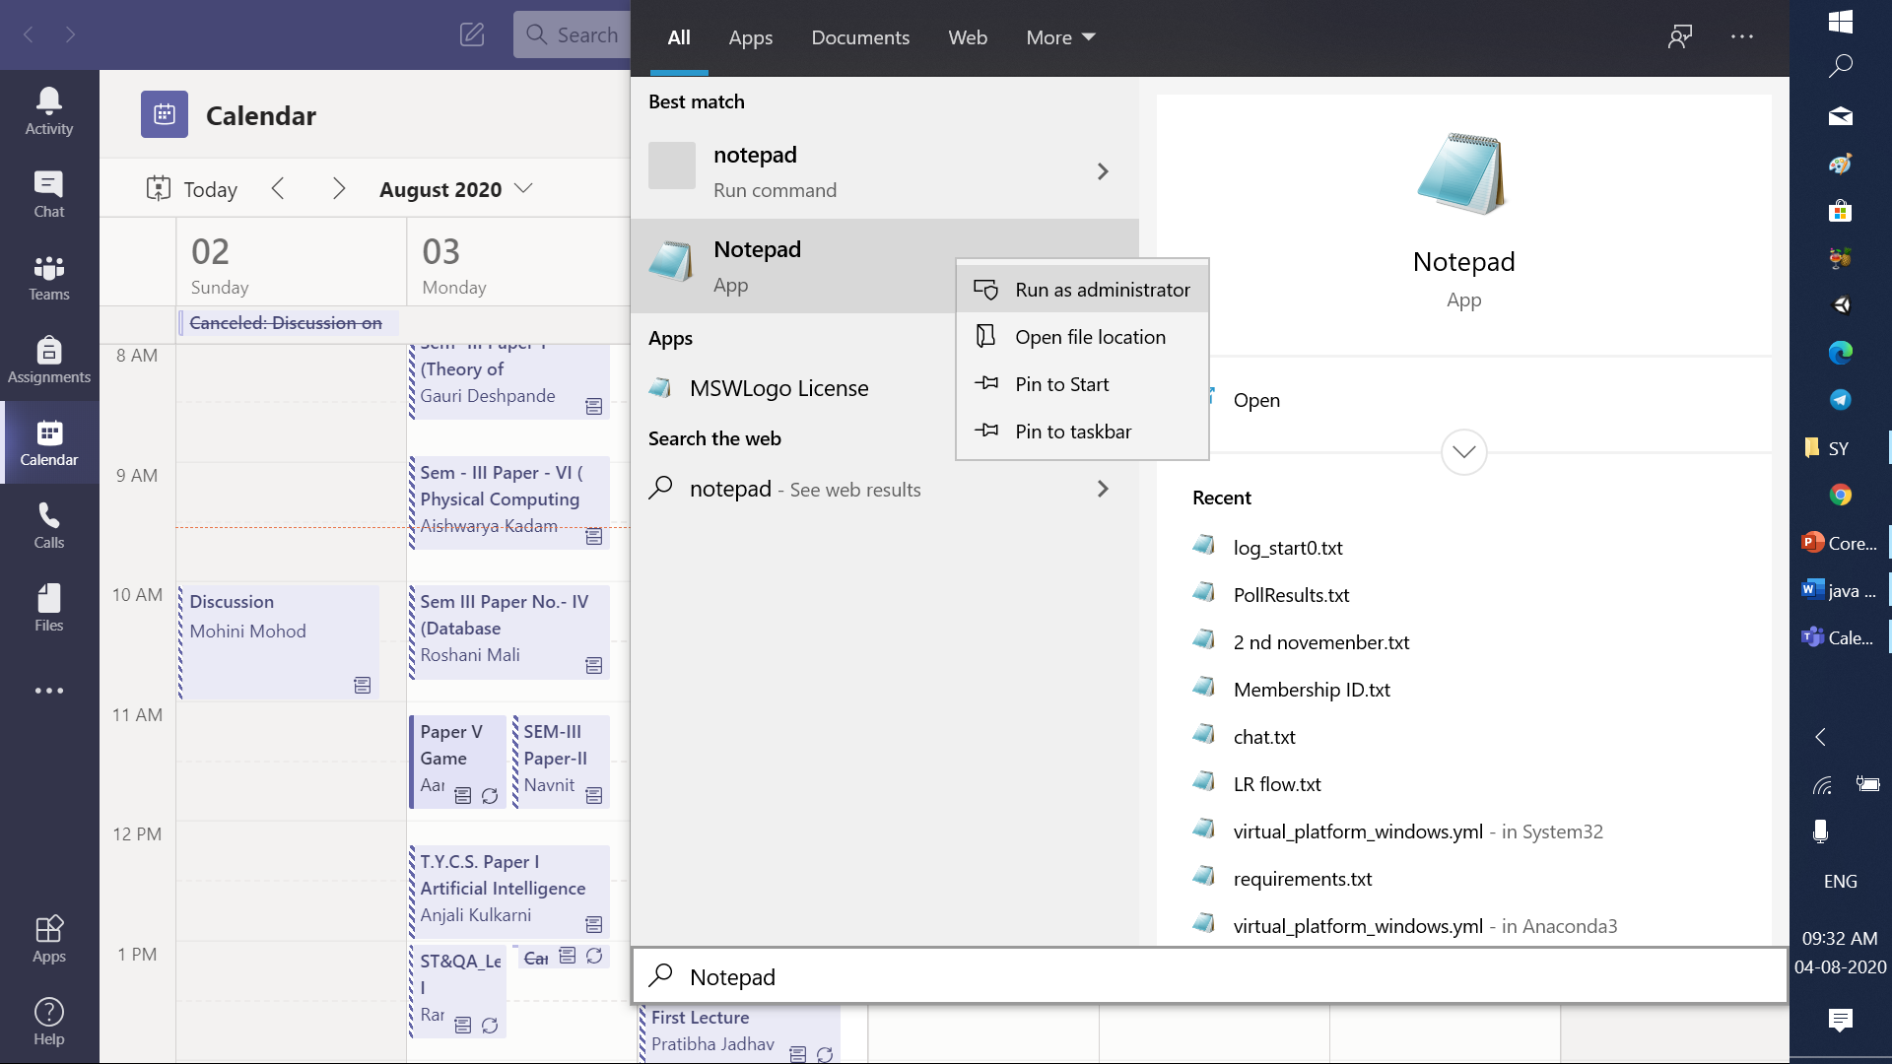

Slide 12
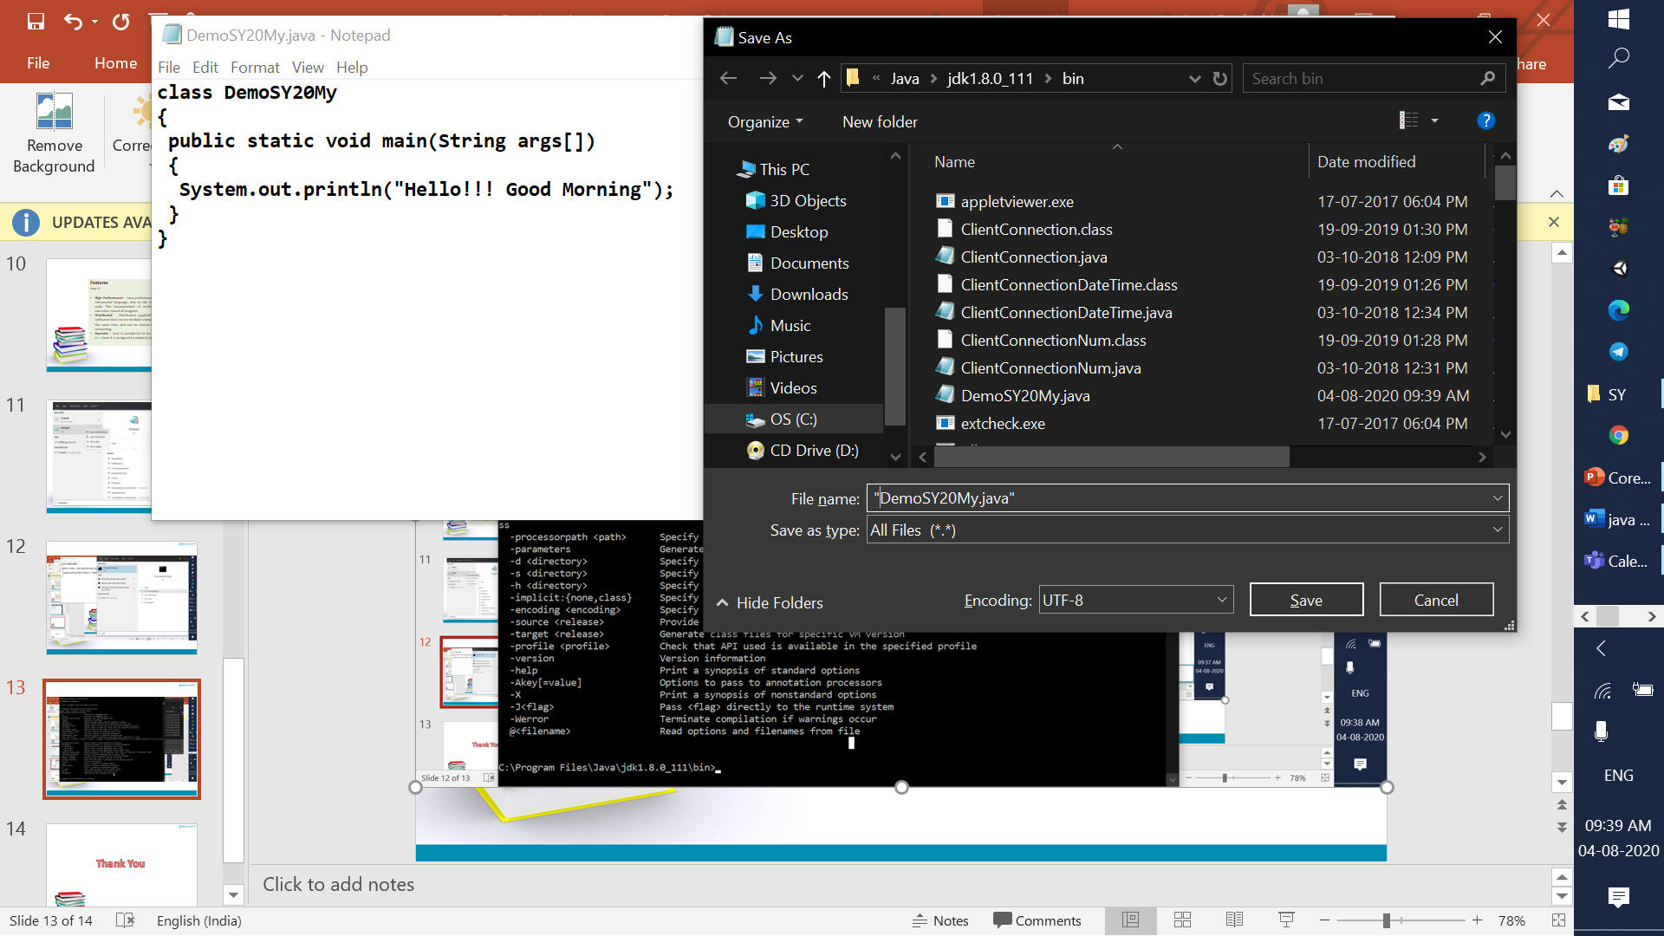

Slide 13
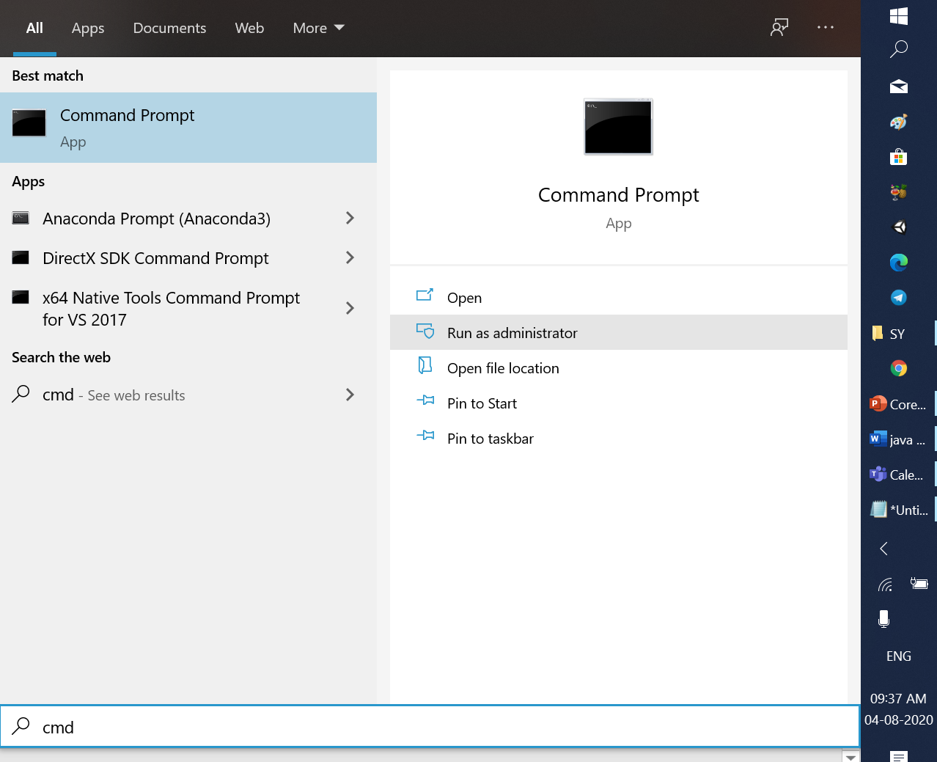

Slide 14
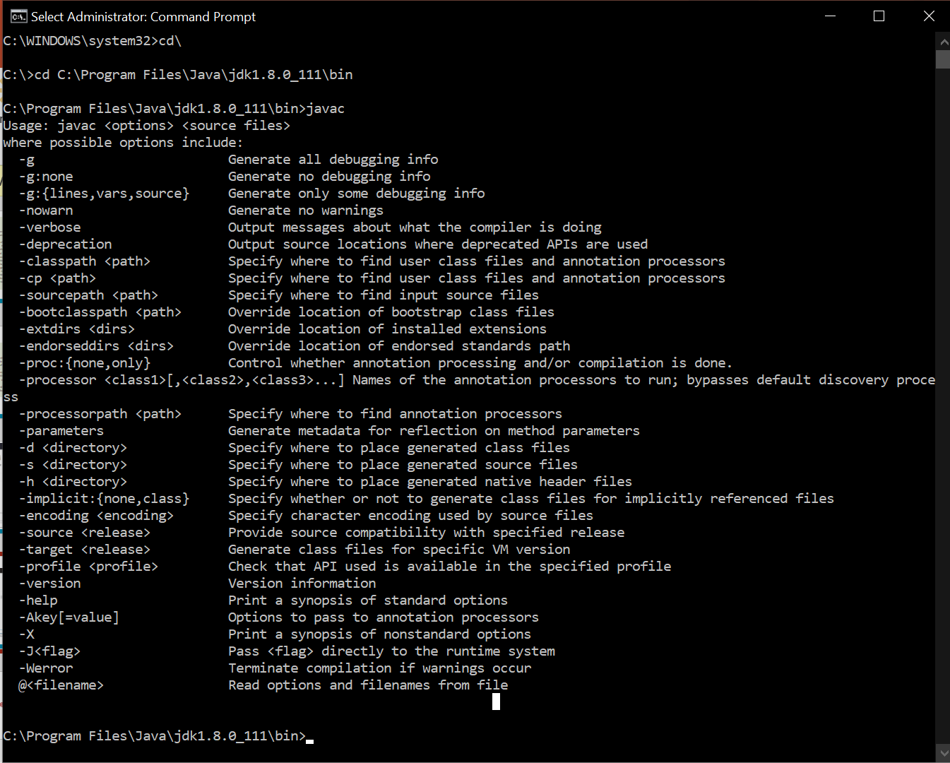

Slide 15
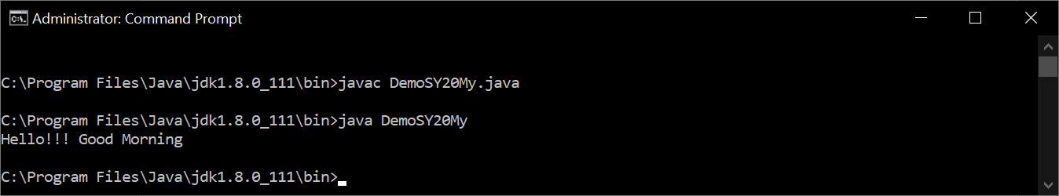

Slide 16
Thank You

